Slide 1


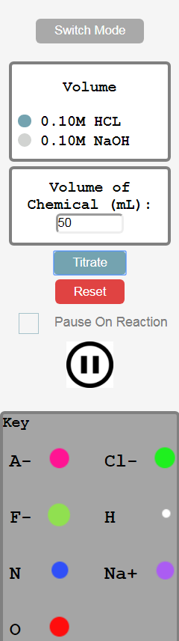
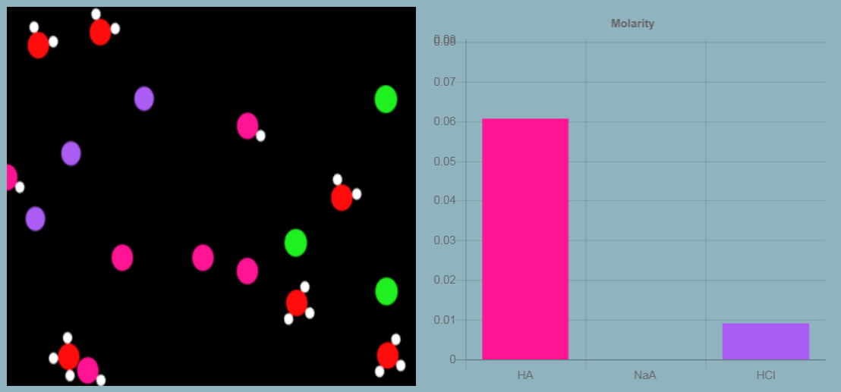
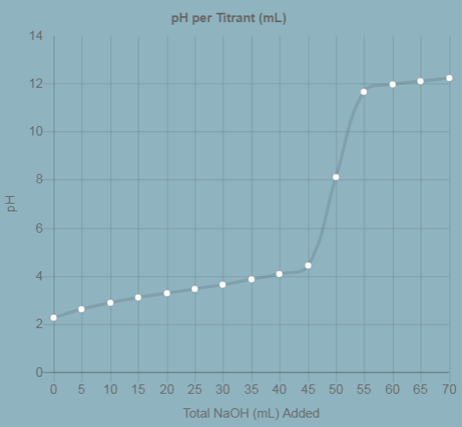
Team GVSU Chemistry: Chemical Buffer Solutions Simulation
Adam Stewart, Brendan Dent, Colin Smith, Connor Butch
Client: GVSU Department of Chemistry (Prof. Jessica VandenPlas)
Overview
User Interaction
Technical Details
Goal:
- Develop a web application that will allow users to simulate a buffer solution that will help visualize many core mechanics regarding acids and bases.
Problem:
The user must be able to select which chemicals to be inserted, in varying amounts, and clearly identify those molecules.
Solution:
-Easy bullet selection for types of chemicals
-Clear user commands through color-coded buttons
-Molecule legend that can be seen at all times
Technical Details:
- WebGL framework named Pixi.js
- Chart.js for bar and line graphs
- HTML/CSS for styling/framework
- Loads of chemistry
Chemical Visualization
Future Work
Having established a strong framework for both visualizing and performing calculations pertaining to common types of chemical reactions, we hope to have enabled others to expand upon our simulation for other modes of titration, or entirely different types of chemical interactions.
Figure 1: Left - Molecules bouncing in a beaker.
Right - Molarity representation of each chemical.
Acknowledgements
Figure 3: Area for users to choose a titration mode, chemicals to insert, how much of each the chosen chemical, pausing features, and a key for reference.
We’d like to formally thank the entire Chemistry Department at Grand Valley, especially Dr. Jessica VandenPlas. They were patient when teaching us new concepts from chemistry (with which we had limited/no prior experience) and helped to make this undertaking fun as well.
Problem:
Chemical interactions can be impossible to observe. It is also difficult to show the pH levels when these reactions occur.
Solution:
- Present students with a virtual “beaker”.
- Add molecules to the solution in consistent ratios when students elect to add chemicals.
- Allow users the ability to have the simulation pause when a reaction occurs, as well as to manually pause at any time.
Results of Reactions
Problem:
Mathematic trends can be difficult to follow when titrating.
Solution:
-Accurate calculations displayed every step of the simulation.
-Line graph allows users to see a correlation between milliliters of titrant added and change in pH
Figure 4: Results section with various calculations and units.
Figure 2: Visual representation of what happens when a weak acid (HF 0.10M) is titrated with a strong base (NaOH 0.10M).

